Slide 1
Variables

Slide 2
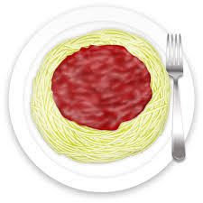


Slide 3


In App inventor
String
Numbers

